Slide 1
INTERNET, INTRANET AND EXTRANET

Slide 2
Internet
The network formed by the co-operative interconnection of a large number of computer networks.
Network of Networks
No one owns the Internet
Every person who makes a connection owns a slice of the Internet.
There is no central administration of the Internet.

Slide 3
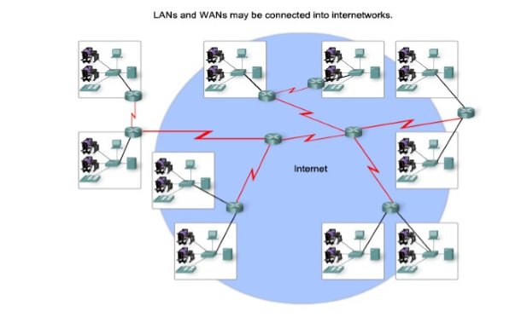
Internet

Slide 4
Internet
Internet is comprises of :
A community of people who use and develop the network.
A collection of resources that can be reached from those networks.
A setup to facilitate collaboration among the members of the research and educational communities world wide. The connected networks use the TCP/IP protocols:
important Internet applications:
world wide web(WWW)
File Transfer Protocol(FTP)
Electronic Mail
Internet Relay Chat

Slide 5
Intranet
A private TCP/IP internetwork within an organization that uses Internet technologies such as Web servers and Web browsers for sharing information and collaborating.
Intranets can be used to publish company policies and newsletters, provide sales and marketing staff with product information, provide technical support and tutorials, and just about anything else you can think of that fits within the standard Web server/Web browser environment.

Slide 6
Intranet
Intranet Web servers differ from public Web servers in that the public must have the proper permissions and passwords to access the intranet of an organization.
Intranets are designed to permit users who have access privileges to the internal LAN of the organization. Within an intranet, Web servers are installed in the network. Browser technology is used as the common front end to access information on servers such as financial, graphical, or text-based data.

Slide 7
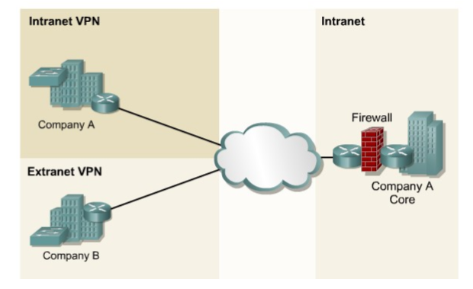

Slide 8
Extranet
Extranets refer to applications and services that are Intranet based, and use extended, secure access to external users or enterprises.
This access is usually accomplished through passwords, user IDs, and other application level security.
An extranet is the extension of two or more intranet strategies with a secure interaction between participant enterprises and their respective intranets.

Slide 9
Extranet
Extranets are a powerful tool because they let businesses share resources on their own private networks over the Internet with suppliers, vendors, business partners, or customers.
Notes:
Extranets are typically used for supporting realtime supply chains, for enabling business partners to work together, or to share information such as catalogs with customers. The power of the extranet is that it leverages the existing technology of the Internet to increase the power, flexibility, and competitiveness of businesses utilizing well-known and easily used tools such as Web servers and Web browsers. Extranets also save companies money by allowing them to establish business-tobusiness connectivity over the Internet instead of using expensive, dedicated leased lines. Extranets can also save money by reducing phone and fax costs.

Slide 10
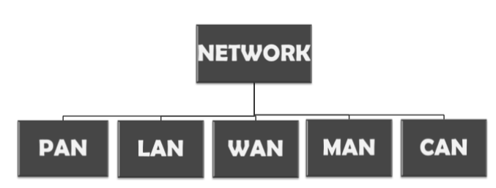
CLASSIFICATION OF NETWORKS BY THEIR GEOGRAPHY

Slide 11
LOCAL AREA NETWORK(LAN)
LAN is a network which is designed to operate over a small physical area such as an office, factory or a group of buildings.
LAN’s are easy to design and troubleshoot
Exchange of information and sharing of resources becomes easy because of LAN.
In LAN all machines are connected to a single cable.
Different types of topologies such as star, tree, bus, ring, e.t.c Can be used
It is usually a privately owned network.

Slide 12
WIDE AREA NETWORK
When network spans over a large distance or when the computers to be connected to each other are at widely separated locations a local area network cannot be used. A wide area network(WAN) is installed.
The communication between different users of WAN is established using leased telephone lines, satellite links and similar channels.
It is cheaper and more efficient to use the phone network for the link.
Most WAN networks are used to transfer large blocks of data between its users.
However LAN is more secure than WAN.

Slide 13
PERSONAL AREA NETWORK(PAN)
A personal area network is a computer network organized around an individual person.
It generally consists of a mobile computer, a cell phone or personal digital assistant.
PAN enables the communication among these devices.
It can also be used for communication among personal devices themselves for connecting to a digital level network and internet.
The PANs can be constructed using wireless or cables.

Slide 14
CAMPUS AREA NETWORK(CAN)
The campus area network is made up of an interconnection of LAN with limited geographical area.
Network equipment such as switches, routers and the transmission media i.e. optical fibre etc. are almost entirely owned by the campus owner.

Slide 15
METROPOLITAN AREA NETWORK(MAN)
It is in between LAN & WAN technology that covers the entire city.
It uses similar technology as LAN.
It can be a single network such as cable TV network, or a measure of connecting a number of LAN’s o a large network so that resources can be shared LAN to LAN as well as device to device.

Slide 16
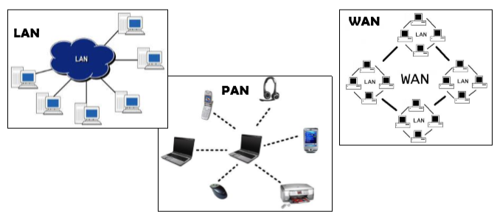

Slide 17
